Slide 1
Vector processors

Slide 2
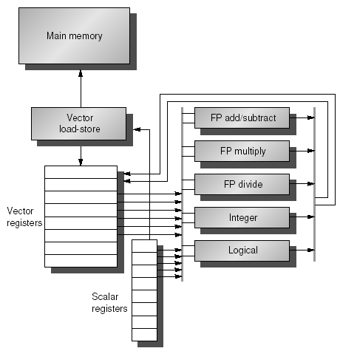

Slide 3
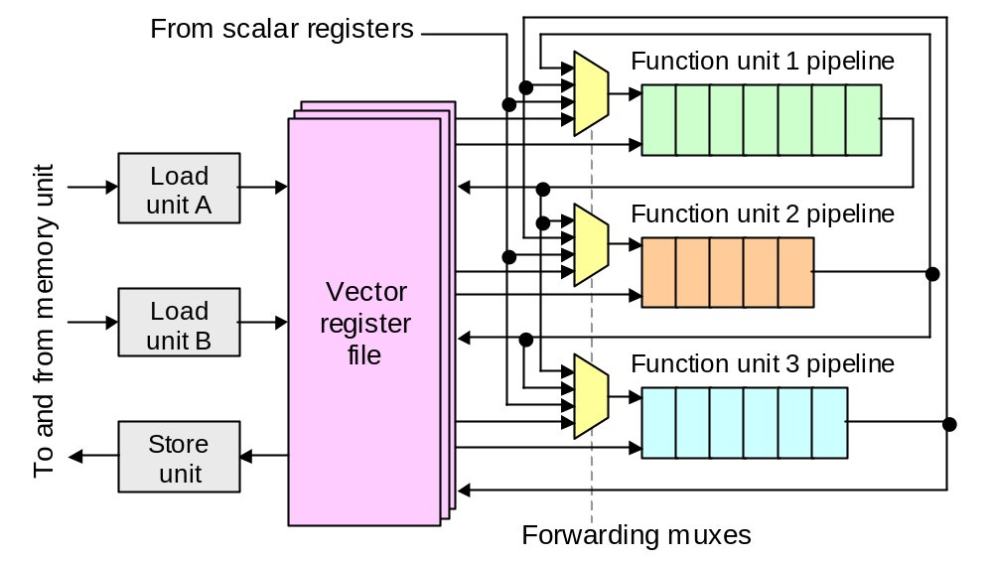

Slide 4
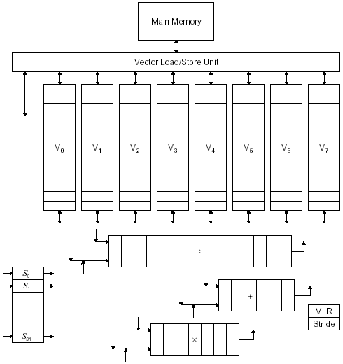

Slide 5
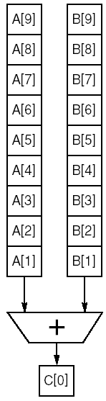
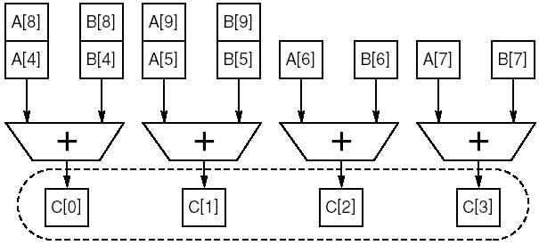

Slide 6
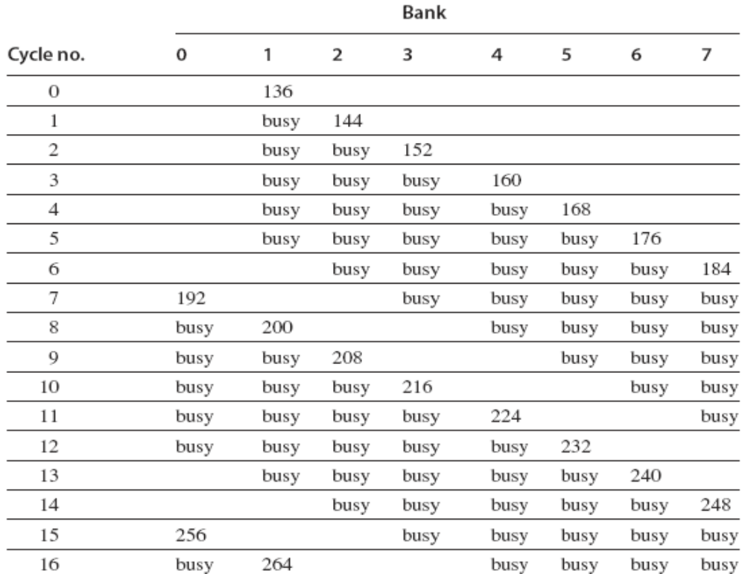

Slide 7
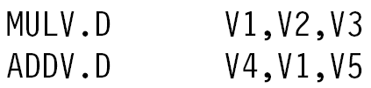

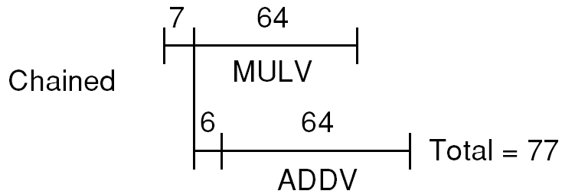

Slide 8
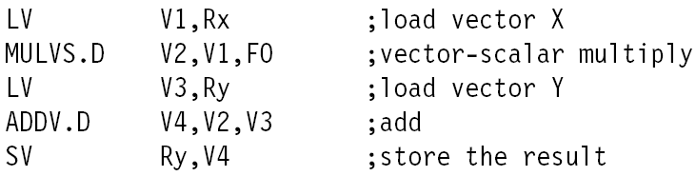


Slide 9
References
J. Hennessy, D. Patterson, Computer Architecture, A Quantitative Approach, Morgan Kaufmann, 2002, Appendix G Vector Processors at http://books.elsevier.com/us/mk/us/subindex.asp?maintarget=companions/defaultindividual.asp&isbn=1558605967&country=United+States&srccode=&ref=&subcode=&head=&pdf=&basiccode=&txtSearch=&SearchField=&operator=&order=&community=mk

